Slide 1
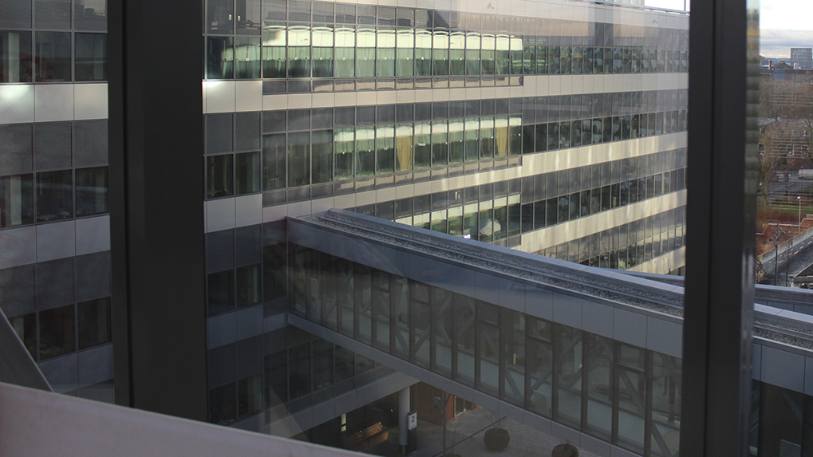

The Compass
TOGETHER WE ARE KAROLINSKA
Our way of working – helping us do the right thing
Version 2.10

Slide 2
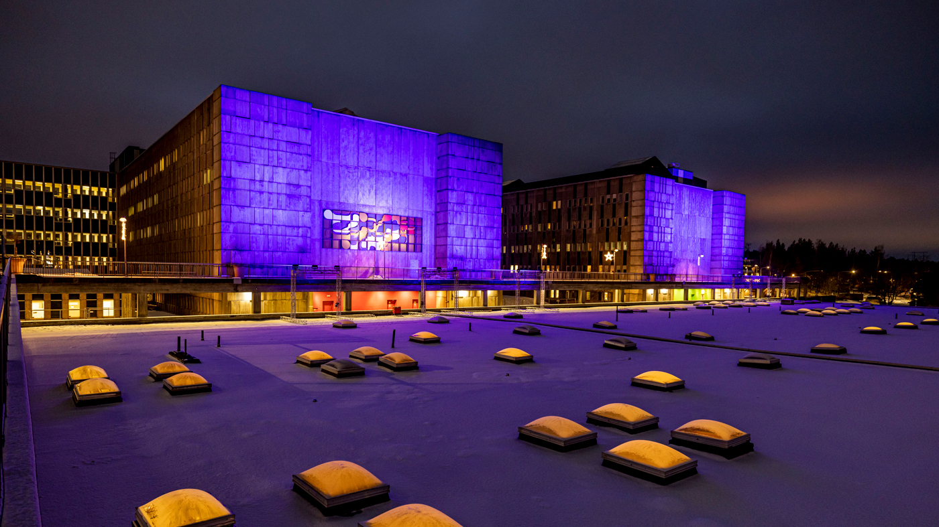





Together
UNIVERSITY HOSPITAL MANDATE
we are Karolinska
Healthcare
Research
Education
The Compass is a guide to help you do the right thing based on our values
VISION
MISSION
VALUES
We will cure and relieve tomorrow what no one can cure and relieve today
We are the best at the most difficult.
We take responsibility for our common resources.
Responsibility
Compassion
Holistic approach

Slide 3


Why Karolinska has the Compass
Karolinska University Hospital (K) is a public body within Region Stockholm. Its activities are publicly funded, which demands high levels of quality, transparency and sustainability. We work on behalf of the public and, as part of wider society, we are all ‘co-owners’ of K.
K as an employer and our whole workforce, including managers, have a shared responsibility to run our operation according to the goals set for it – together.
What the Compass contains
The Compass is based on the laws, conventions, guidelines and Region Stockholm’s policy documents, including basic principles of public administration and human rights, that we all have to follow as employees of K.
Who the Compass is for
The Compass is a cross-party document and applies to everyone participating in its activities by virtue of employment, assignment or similar – including temporary staff, researchers, students and others who carry out their work at K. In this document, the term ‘employee’ refers to all these categories, not least managers.

Slide 4
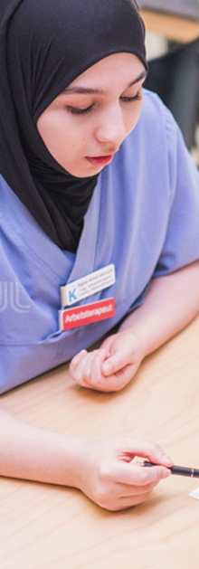
The purpose of the Compass – for me
As an EMPLOYEE at K, you are its most important resource. In this capacity you represent the hospital, both within K and in your contact with the wider world. You therefore need to be familiar with the content of the Compass and reflect on how it can be applied in the performance of your duties.
As a MANAGER, you have a particular responsibility to ensure an open environment where employees can report suspected violations of the law and our governing documents without risk of reprisal. You must also set a good example, help employees to do the right thing and take action in cases of non-compliance with the Compass.
While the Compass is a guide to doing the right thing, you are expected to make your own judgements, think through your decisions and seek out help and advice if necessary.
Support in the employee contract
An employment relationship is based on reciprocity and trust. The Compass helps with clarifying the employee contract – the responsibilities of K as an employer and the responsibilities of all employees and managers at K.
Protection against reprisals for those who report suspected violations
You are encouraged, and have a responsibility as an employee, to point out when something breaches our governing regulations and shared commitments such as those set out in the Compass.
You should feel confident in reporting suspected violations. On page 17 you will find a summary of the reporting channels available within K and externally.

Slide 5
My relationships at Karolinska
The Compass focuses on you, the employee.
Notes:
[text in figure]
PATIENTS & RELATIVES
OTHER EMPLOYEES
YOU
K AS AN EMPLOYER
WIDER WORLD

Slide 6
My relationships at Karolinska
Depending on the nature of your job, you may rarely find yourself in some of the situations described. You should still familiarize yourself with the entire Compass. You need to be fully aware of the elements that are most relevant to your role. If there is anything you don’t understand or agree with, speak to your manager.
Our key principles, as set out in the following pages, fall into four categories.
Myself, as an employee of the hospital, IN RELATION TO ...
1
PATIENTS AND RELATIVES
– our core focus
2
OTHER EMPLOYEES
– our working environment
3
K AS AN EMPLOYER
– our shared workplace
4
WIDER WORLD
– the trust we nurture
from a larger perspective

Slide 7
In relation to PATIENTS AND RELATIVES
OUR
CORE FOCUS
Our guiding principles! | What does this mean for me?
We respect the equal value of every individual and work towards inclusive, accessible and sustainable healthcare. | I treat every patient and family member professionally, with kindness and respect. I contribute to making the hospital accessible to everyone so that all individuals can express themselves, access, convey, and interpret information about their healthcare situation, as well as visit the hospital premises without obstacles.
We work to high quality standards and put patient safety first. All patients should feel confident that they are receiving good, safe and equitable care. | I protect our patients’ personal information. I always follow basic hygiene procedures. I help to improve the quality of care and patient safety by pointing out shortcomings and identifying improvement measures.
We take the patients’ needs and wishes as our starting point. | I involve the patient in their own care.
We are transparent, accessible and invite participation and cooperation. | I enable patients and relatives to help develop care by taking on board feedback and suggestions for improvement.
We safeguard our integrity in our professional role and do not have private contact with patients or relatives during the period of care. I can of course have private contact with patients who I am personally close to. | I do not disclose my private contact details to patients or relatives.
Our research, education and innovation mandate is an integral part of our daily work, aimed at developing the healthcare of tomorrow and the healthcare professionals of the future. | We give patients the opportunity to participate in research, education and innovation projects, but we are clear that this is entirely voluntary.

Slide 8
In relation to OTHER EMPLOYEES
OUR WORKING ENVIRONMENT
Our guiding principles! | What does this mean for me?
We have zero tolerance for discrimination, harassment and victimization. | I respect the integrity and differences of my colleagues. I never use derogatory language about others.
We are committed to a workplace with gender equality and equal opportunities. This means that everyone, whether a manager or an employee, treats their colleagues equally. | I say hello to my colleagues and look out for everyone’s wellbeing. I act if I suspect a colleague is not feeling well.
We offer our students the support and teaching they need to be confident in, and have the right skills for, their future careers. | I see each student as a future colleague and contribute to their learning, based on my skills.
We actively work to create a safe and healthy workplace, with a friendly and inclusive climate. | I wear the correct personal protective equipment. I protect myself and my colleagues by being alert to risks in the working environment. I mitigate these risks by reporting them so they can be addressed. I also report incidents and suggestions for improvement to create a safer and better working environment.
We support and see the potential in each other and collaborate across boundaries, in order to get a full picture of the care we provide. | I empower other employees and promote good cooperation across thematic, functional and staff boundaries – with colleagues in all professional groups. I share my knowledge and experience, and am open to learning from the skills and expertise of others.

Slide 9
In relation to K AS AN EMPLOYER
OUR SHARED WORKPLACE
Our guiding principles! | What does this mean for me?
We act independently, ethically and in accordance with the values of Karolinska. As public servants, we act objectively and impartially. | I raise the issue with my manager if I’m not sure what to do. I treat everyone equally, no matter who they are.
Those of us who are licensed practitioners have a personal responsibility to practise our profession in accordance with science and proven experience. The employer is responsible for enabling this to be achieved, which includes providing adequate skills development. | I take personal responsibility for keeping up to date with new knowledge in my field of work and participate in the professional development that is offered. I speak up if I don’t think I have the right skills for the job.
We respect the applicable governing documents and do not hesitate to ask for help in interpreting them. | I actively seek support and knowledge to ensure that I am in a position to work in accordance with laws, procedures and guidelines. I speak up if I feel I am not in a position to work in accordance with the laws, procedures and guidelines.

Slide 10
In relation to the WIDER WORLD:
Environmental sustainability
THE TRUST WE NURTURE FROM A WIDER PERSPECTIVE
Our guiding principles! | What does this mean for me?
Our operations must be conducted with the least possible environmental impact. | I ensure that the materials used in our operations comply with our environmental and sustainability requirements. When purchasing, I base my decisions exclusively on our agreements and prioritize solutions with the lowest possible impact, in order to contribute to sustainable development. I conserve materials and energy and use efficient transport solutions. I try to take a circular approach and look for new sustainable solutions (for example for consumables and energy use). I actively seek information about, and follow, the rules for handling medicines, chemicals and waste. I take responsibility for the correct handling and sorting of waste.

Slide 11
In relation to the WIDER WORLD:
Environmental sustainability
THE TRUST WE NURTURE FROM A WIDER PERSPECTIVE
Our guiding principles! | What does this mean for me?
Our operations must be conducted with the least possible environmental impact. | I ensure that the materials used in our operations comply with our environmental and sustainability requirements. When purchasing, I base my decisions exclusively on our agreements and prioritize solutions with the lowest possible impact, in order to contribute to sustainable development I conserve materials and energy and use efficient transport solutions I strive to apply a circular approach and seek to identify new sustainable solutions (for example for consumables and energy use) I actively seek information about, and follow, the rules for handling medicines, chemicals and waste I take responsibility for ensuring that waste is handled and sorted correctly I conduct sustainability trainings and have the appropriate sustainability competence for my duties I support and introduce my colleagues to our local sustainability work I report environmental deviations in cases of non-compliance with guidelines, procedures, legislation, permits, or any actual or potential harm to the external environment I carry out environmental inspections to help us improve in the environmental area

Slide 12
In relation to the WIDER WORLD:
Publicity and information management
THE TRUST WE NURTURE FROM A WIDER PERSPECTIVE
Our guiding principles! | What does this mean for me?
We are aware that K is a public body operating under the principle of public access to official documents. This means that anyone in society, including the media, has the right to see and access information about K’s activities. | I am aware that e-mails to anyone outside the hospital are considered public documents and can be requested by the public. I am aware that the public has the right to contact me, as an employee of K, to request public documents. In such cases, I am responsible for the production of the documents and the processing of the request.
We ensure that the right information can be found, both now and in the future, by filing the documents that need to be filed. | I find out the record keeping rules for my particular job.
We keep our information and documents in order. This is vital for adherence to the principle of public access to official documents, while also promoting transparency and public confidence in K. | If I am also an employee of Karolinska Institutet (KI), I keep my e-mail accounts separate, and in my capacity as a K employee I always reply from my K account.
We are careful to maintain confidentiality inside and outside the hospital. | I find out what information is protected by confidentiality before I disclose it. I do not talk about classified information in public places. I do not send confidential information by e-mail, either internally or externally.

Slide 13
In relation to the WIDER WORLD:
Information security, IT security and e-mail
THE TRUST WE NURTURE FROM A WIDER PERSPECTIVE
Our guiding principles! | What does this mean for me?
We protect sensitive information. | I always log out and take my e-service card with me when I leave the computer. I’m careful about opening e-mails from senders I don’t know. I never click on links or open files from unknown senders. I never lend out my e-service card or password. I regularly restart my computer to install updates, for IT security reasons.
We are aware of what information we are allowed to access, through our assigned permissions. | I handle sensitive information in purpose-built and secure systems. I behave safely and use computers, mobile phones, the internet and e-mail only as work tools in accordance with the hospital’s guidelines.
We act quickly to report incidents and breaches that could have a negative impact on privacy or information security. | I will report to my immediate manager or to the local information security coordinator if my personal data or the personal data of others has been handled in a way that I feel is inappropriate.

Slide 14
In relation to the WIDER WORLD:
Social media and our dialogue with the wider world
THE TRUST WE NURTURE FROM A WIDER PERSPECTIVE
Our guiding principles! | What does this mean for me?
We want external communication to give an accurate, consistent and transparent picture of our hospital and our activities. | I am aware of my right to freedom of speech and freedom of communication as a public employee, and of their limitations (including patient confidentiality). Freedom of communication applies only to verbal information. Freedom of communication also means that the employer is not allowed to investigate who has disclosed the information. I am always able to refer the media to the press office, or a designated spokesperson where one exists.
We all have the right, when dealing with the media, to freely express our own opinion and convey our own interpretation of the facts (anonymously or openly). | I am aware that the image I convey, with regard to the work and role of K, reaches a wide audience and is of general interest to the public.
We protect our own and others’ privacy on social media. | I bear in mind that images and texts published on social media can easily spread and be misunderstood if taken out of context. I don’t post pictures of anyone without their consent. I refrain from contact with patients and their relatives outside work.

Slide 15
In relation to the WIDER WORLD:
Secondary employment and conflicts of interest
THE TRUST WE NURTURE FROM A WIDER PERSPECTIVE
Our guiding principles! | What does this mean for me?
We report secondary employment and other external work. | I notify my immediate supervisor of any secondary employment through Heroma. I am responsible for providing additional information if anything changes in relation to the secondary employment I have previously reported. If I work as an expert, for example on advisory board assignments, I do so as part of my job at K and compensation for participation is payable by K.
We are aware of the legal rules on professional misconduct and comply with them. | I do not take part in discussions or decisions if I have personal links with the matter or the person to which the decision applies (for example, in the case of employing a close relative). I tell my boss if I think I might be guilty of misconduct.
Those of us with multiple employers are aware that different rules may apply to each employer. | If I have joint employment, for example with KI, I keep the different roles and their powers separate.

Slide 16
In relation to the WIDER WORLD:
Financial irregularities and bribery
THE TRUST WE NURTURE FROM A WIDER PERSPECTIVE
Our guiding principles! | What does this mean for me?
We have zero tolerance for financial irregularities of any kind. We must never request, accept, pay or offer to pay bribes, either directly or through anyone acting on our behalf. | I cannot accept gifts that could be perceived to influence me in my role at K. I can never accept alcohol, gift cards or anything that can be equated with money, such as expensive gifts of clothes or shoes, from an external person. A gift to show appreciation to or from a colleague is normally allowed. I can accept flowers or cake for the whole team, as well as a symbolic gift of negligible value. I am alert to situations that may be perceived as giving me an undue advantage, such as being invited to dinner or on a trip by an external person. This applies regardless of who offers the benefit.
We conduct business with a high level of integrity, and do not tolerate bribery or corruption in any form. | I do not accept anything that could be perceived as influencing me in the performance of my duties, for example in relation to suppliers.
We contribute to a healthy business environment in the marketplace by demanding the same standards from our suppliers as we do from ourselves. | I use agreed suppliers for all purchases that generate an invoice, or turn to the purchasing department for help.

Slide 17
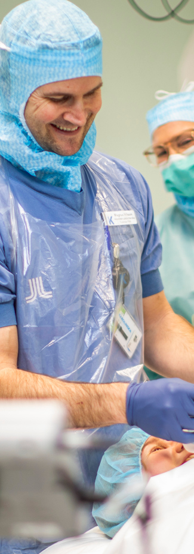
If you have a question
In the first instance, always contact your manager, your manager’s manager or the central department to which your question relates, such as HR or the Legal Department.
If you want to report an incident
Internal
If you want to report an incident or risk relating to health and safety, care or the environment, or have a suggestion for improvement, you should do so through HändelseVis. Suggestions for improvement can also be sent to forbattringsforslag.karolinska@regionstockholm.se.
If you wish to report a suspected violation of the Compass, please do so to your manager, your manager’s manager, HR or the hospital’s lawyers.
A personal data breach, other information incident or IT incident must be reported without delay both as instructed on Inuti and to cert@regionstockholm.se.
Whistleblowing
If you suspect serious wrongdoing involving senior or key personnel, you can report it anonymously through K’s external whistleblowing channel. As a whistleblower, you are protected against all forms of reprisals. You can read more about how these cases are handled here.
External
You can also turn to one of our supervisory authorities, e.g. the Health and Social Care Inspectorate – IVO.

Slide 18
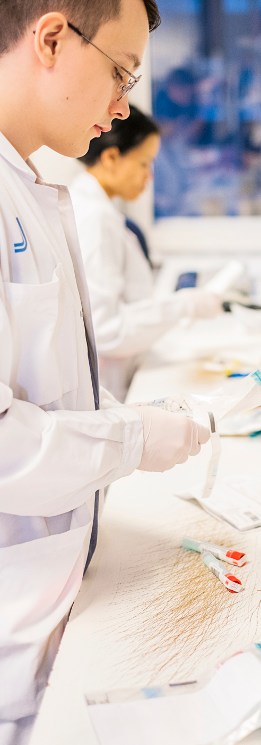
Violations of the Compass
The Compass is a tool to help employees and managers do the right thing.
As an employee or a manager, deliberately violating the principles of the Compass may have consequences under employment law.
The way you take on board the principles of the Compass is an important part of what we call employeeship. Doing your best to act in accordance with the principles of the Compass is good employeeship!

Slide 19

TOGETHER WE ARE ...

